Slide 1
METHODS OF INTEGRATION
7.1. Review of Substitution and Integration by Tables 7.2. Integration by parts 7.3. Trigonometric methods 7.4. Method of Partial Fractions 7.5. Summary of Integration Techniques

Slide 2





The Substitution Rule
$$\int{f\left(x\right)dx=}\int{\underset{f\left(x\right)}{\underbrace{F\left(u\left(x\right)\right)u^{′}\left(x\right)}}dx=\int{F\left(u\right)du}}$$
$$\int_{a}^{b}{f\left(x\right)dx}=\int_{a}^{b}{\underset{f\left(x\right)}{\underbrace{F\left(u\left(x\right)\right)u^{′}\left(x\right)}}dx}=\int_{u(a)}^{u(b)}{F\left(u\right)du}$$
Example: Find each integral:
$$1. \int{\frac{dx}{x\ln{x} }}$$
$$2. \int{\cos{xe^{\sin{x}}dx }}$$
$$3. \int{\frac{t^{2}dt}{9+t^{6} }}$$
$$4. \int{\frac{2x−1}{{\left(4x^{2}−4x\right)}^{2} }dx}$$

Slide 3
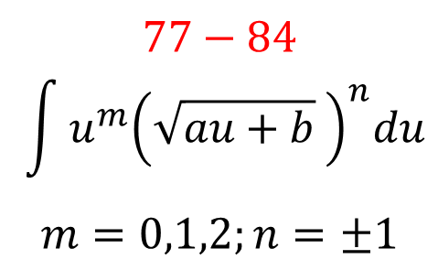
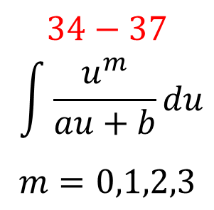
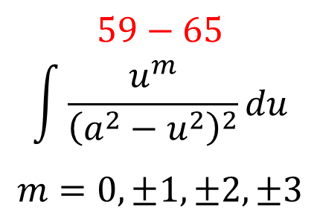
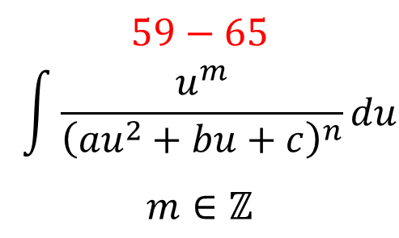
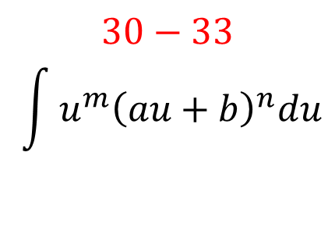
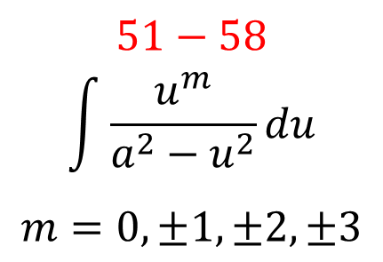
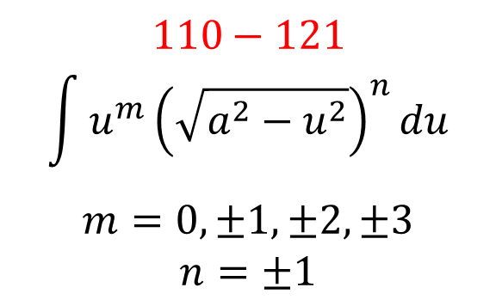
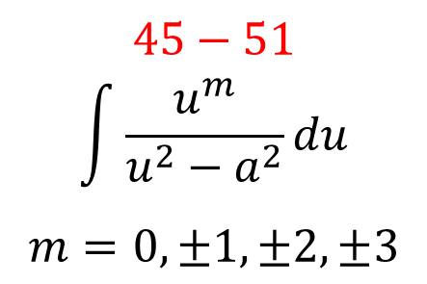
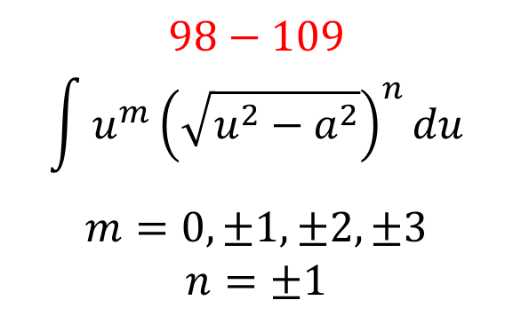
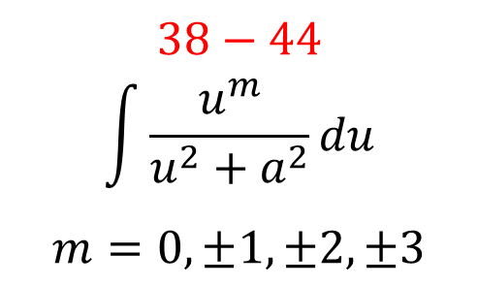
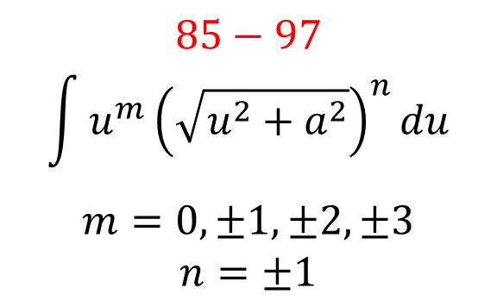
Integration Using Tables
$$30−33$$
$$\int{{u^{m}\left(au+b\right)}^{n}du}$$
$$34−37$$
$$\int{\frac{u^{m}}{au+b}du }$$
$$m=0,1,2,3$$
$$38−44$$
$$\int{\frac{u^{m}}{u^{2}+a^{2}}du }$$
$$m=0,±1,±2,±3$$
$$45−51$$
$$\int{\frac{u^{m}}{u^{2}−a^{2}}du }$$
$$m=0,±1,±2,±3$$
$$51−58$$
$$\int{\frac{u^{m}}{a^{2}−u^{2}}du }$$
$$m=0,±1,±2,±3$$
$$59−65$$
$$\int{\frac{u^{m}}{{\left(a^{2}−u^{2}\right)}^{2}}du }$$
$$m=0,±1,±2,±3$$
$$59−65$$
$$\int{\frac{u^{m}}{{\left({au}^{2}+bu+c\right)}^{n}}du }$$
$$m∈ℤ$$
$$77−84$$
$$\int{u^{m}{\left(\sqrt{au+b} \right)}^{n}du }$$
$$m=0,1,2;n=±1$$
$$85−97$$
$$\int{u^{m}{\left(\sqrt{u^{2}+a^{2}}\right)}^{n}du }$$
$$m=0,±1,±2,±3$$
$$n=±1$$
$$98−109$$
$$\int{u^{m}{\left(\sqrt{u^{2}−a^{2}}\right)}^{n}du }$$
$$m=0,±1,±2,±3$$
$$n=±1$$
$$110−121$$
$$\int{u^{m}{\left(\sqrt{a^{2}−u^{2}}\right)}^{n}du }$$
$$m=0,±1,±2,±3$$
$$n=±1$$

Slide 4
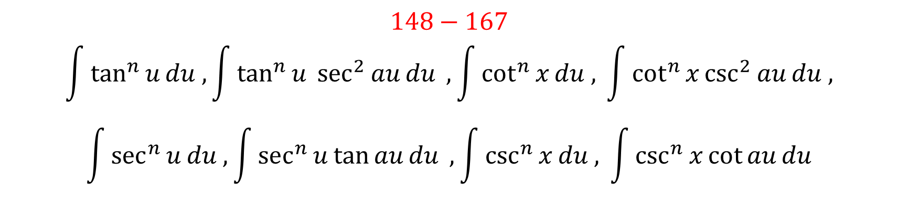
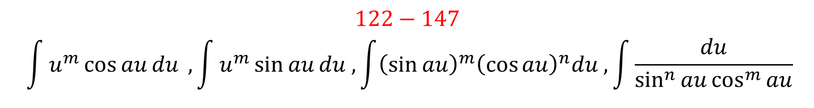
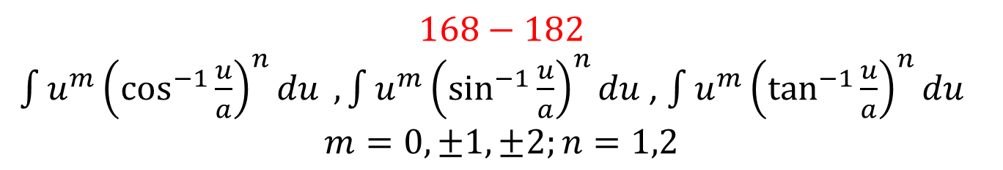
Integration Using Tables
$$122−147$$
$$\int{u^{m}\cos{au}du },\int{u^{m}\sin{au}du ,\int{{\left(\sin{au}\right)}^{m}{\left(\cos{au}\right)}^{n}du ,\int{\frac{du}{\sin^{n}{au\cos^{m}{au}}}}}}$$
$$148−167$$
$$\int{\tan^{n}{u}du ,}\int{\tan^{n}{u}\sec^{2}{au}du },\int{\cot^{n}{x}du , }\int{\cot^{n}{x}\csc^{2}{au}du , }$$
$$\int{\sec^{n}{u}du ,}\int{\sec^{n}{u}\tan{au}du },\int{\csc^{n}{x}du , }\int{\csc^{n}{x}\cot{au}du}$$
$$168−182$$
$\int{u^{m}{\left(\cos^{−1}{\frac{u}{a}}\right)}^{n}du },\int{u^{m}{\left(\sin^{−1}{\frac{u}{a}}\right)}^{n}du }$, $\int{u^{m}{\left(\tan^{−1}{\frac{u}{a}}\right)}^{n}du }$
$$m=0,±1,±2;n=1,2$$

Slide 5
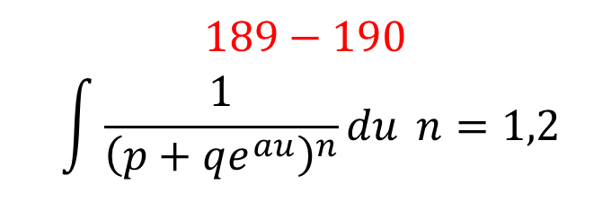
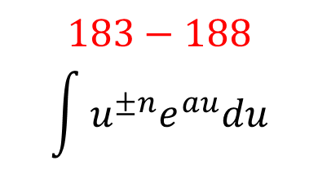
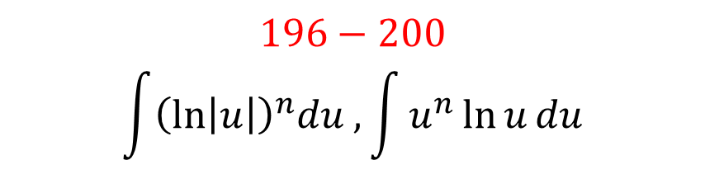
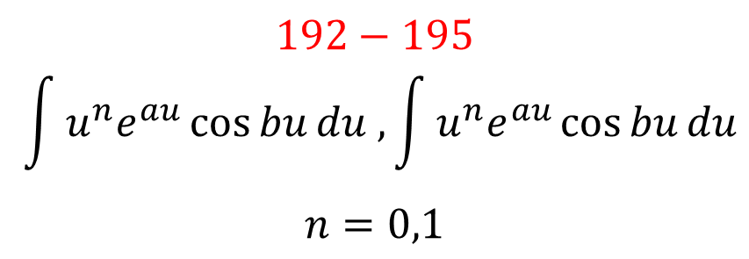
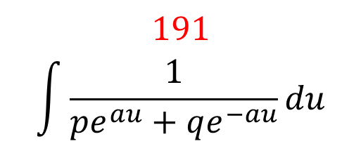
Integration Using Tables
$$183−188$$
$$\int{u^{±n}e^{au}du }$$
$$189−190$$
$$\int{\frac{1}{{\left(p+qe^{au}\right)}^{n}}du }n=1,2$$
$$191$$
$$\int{\frac{1}{pe^{au}+qe^{−au}}du }$$
$$192−195$$
$$\int{{u^{n}e}^{au}\cos{bu}du ,\int{{u^{n}e}^{au}\cos{bu}du }}$$
$$n=0,1$$
$$196−200$$
$$\int{{\left(\ln\left|u\right|\right)}^{n}du ,\int{u^{n}\ln{u}du }}$$

Slide 6
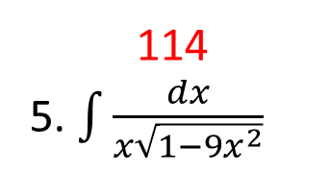
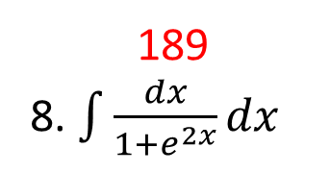
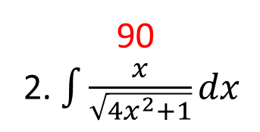
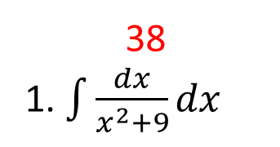
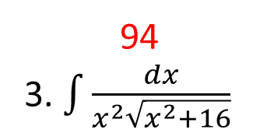

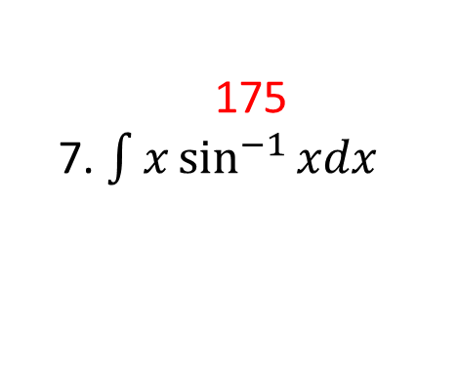
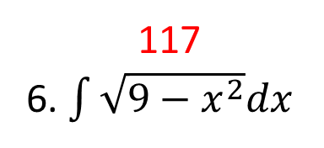

Integration Using Tables
38
1. $\int{\frac{dx}{x^{2}+9}dx}$
90
2. $\int{\frac{x}{\sqrt{4x^{2}+1}}dx}$
94
3. $\int{\frac{dx}{x^{2}\sqrt{x^{2}+16}}}$
103
4. $\int{\frac{dx}{x^{2}\sqrt{x^{2}−a^{2}}}}$
114
5. $\int{\frac{dx}{x\sqrt{1−9x^{2}}}}$
117
6. $\int{\sqrt{9−x^{2}}dx}$
175
7. $\int{x\sin^{−1}{xdx}}$
189
8. $\int{\frac{dx}{1+e^{2x}}dx}$
192
9. $\int{e^{−4x}\sin{5xdx}}$

Slide 7

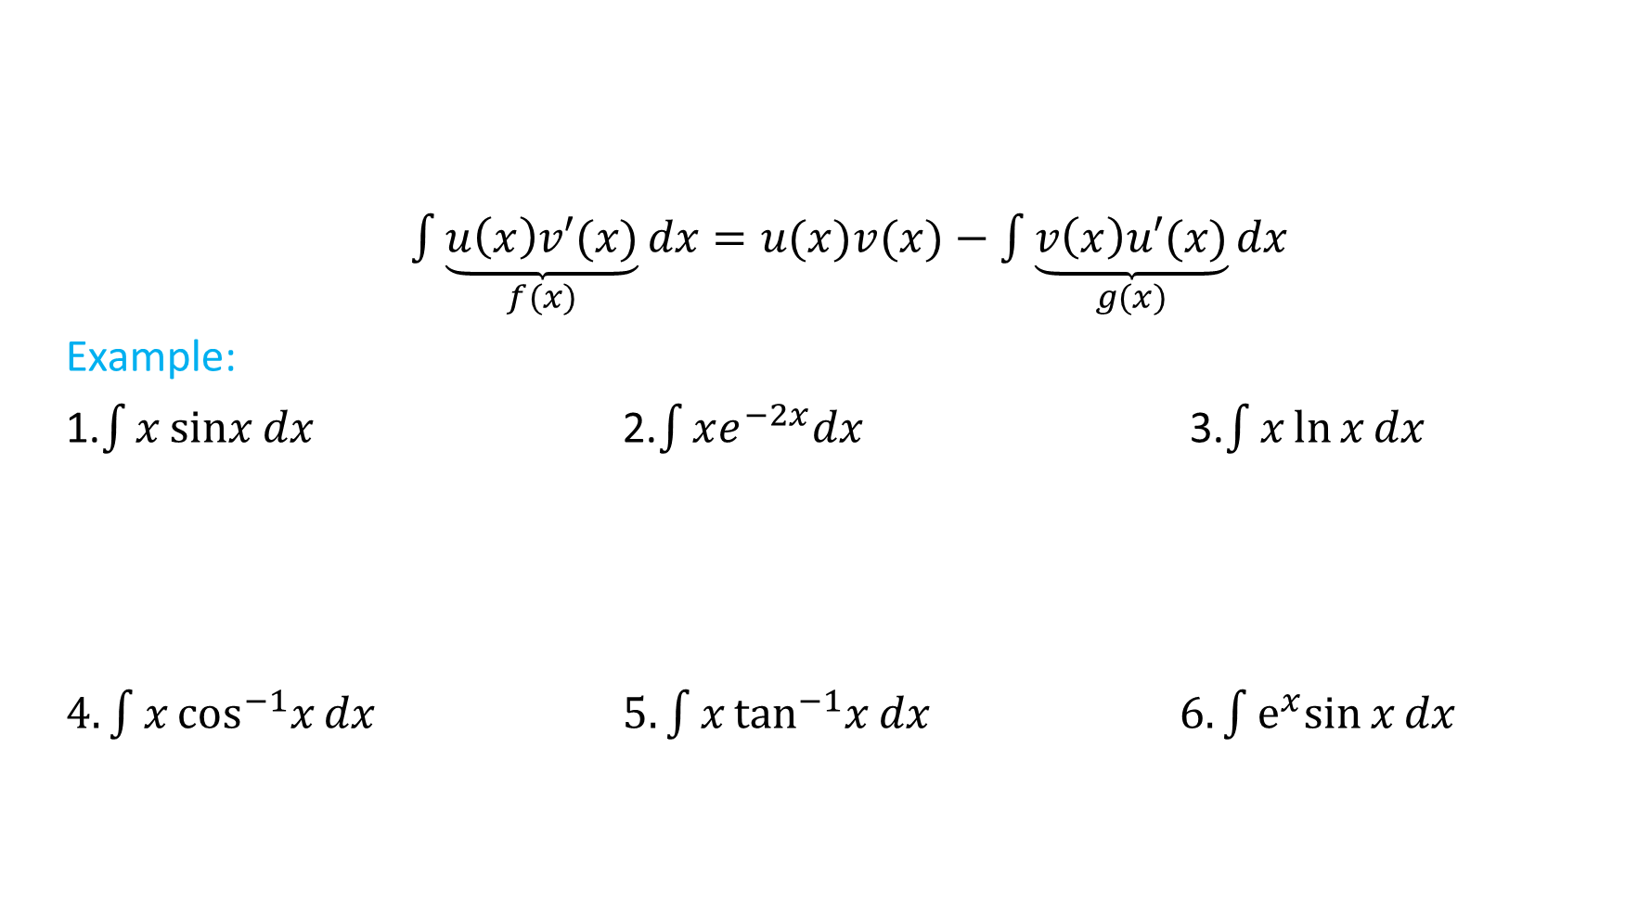
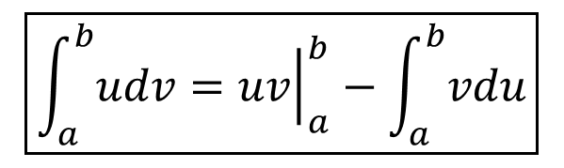
Integration by Parts
$$\boxed{\int{udv}=uv−\int{vdu}}$$
$\int{\underset{f(x)}{\underbrace{u\left(x\right)v′(x)}}dx}=u(x)v(x)−\int{\underset{g(x)}{\underbrace{v\left(x\right)u′(x)}}dx}$
Example:
1.$\int{x\operatorname{sinx}{dx}}$ 2.$\int{xe^{−2x}dx}$ 3.$\int{x\ln{x}dx}$
$4.\int{x\cos^{−1}x{dx}}$ $5.\int{x\tan^{−1}x{dx}}$ $6.\int{e^{x}sin{x}dx}$
$$\boxed{\int_{a}^{b}{udv}={\left.uv\right|}_{a}^{b}−\int_{a}^{b}{vdu}}$$

Slide 8
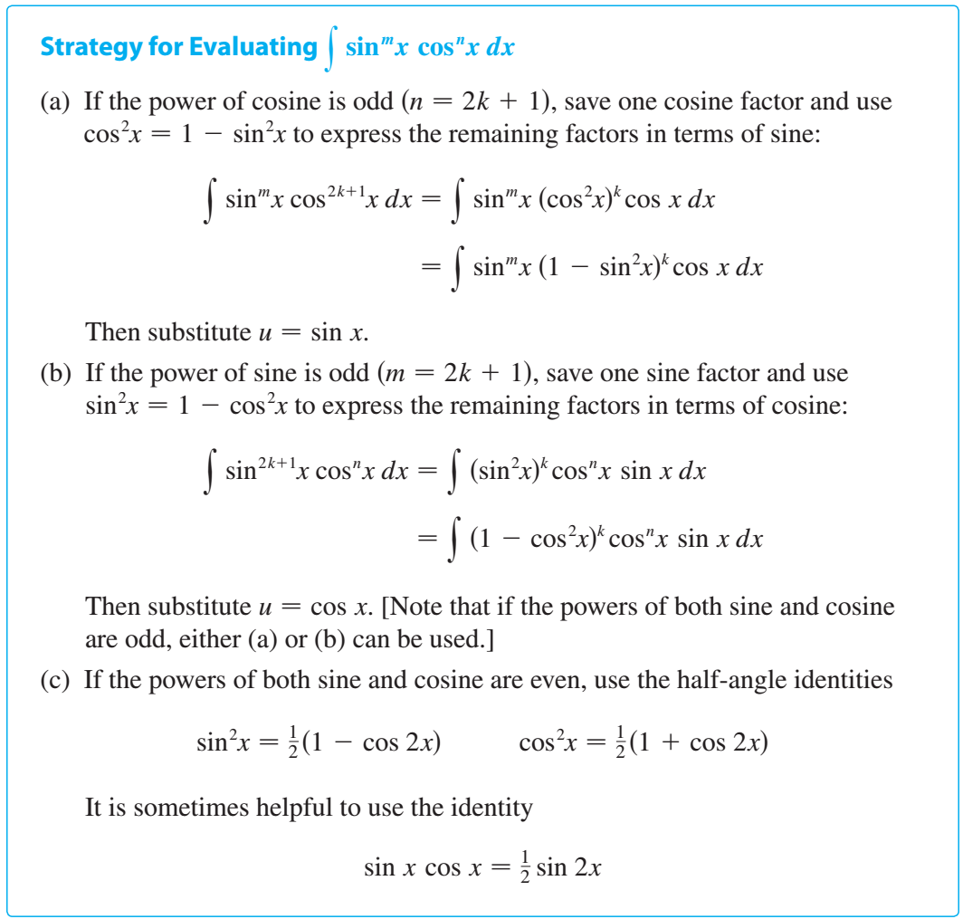
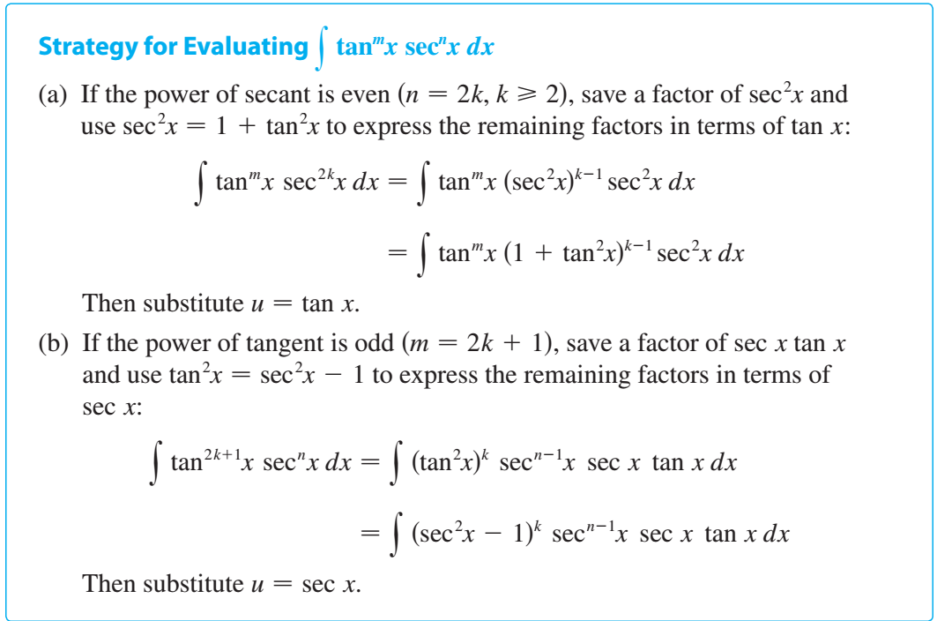

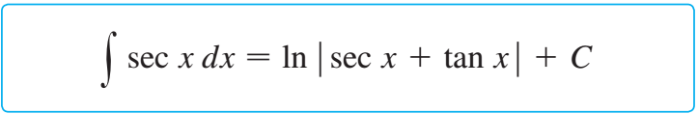
Trigonometric Integrals

Slide 9
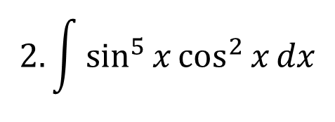
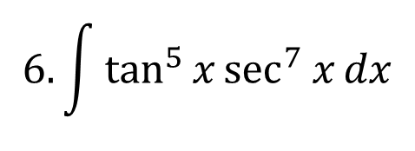
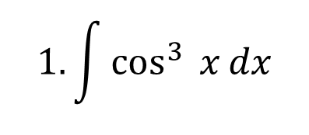
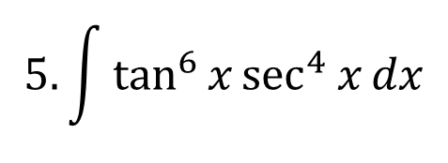
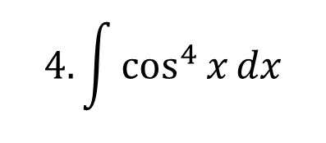
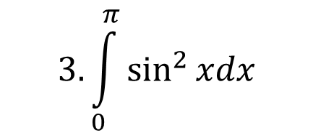
Trigonometric Integrals
$$1.\int{\cos^{3}{ x}dx}$$
$$2. \int{\sin^{5}{x}\cos^{2}{x}dx}$$
$$3. \int_{0}^{π}{\sin^{2}{xdx}}$$
$$4. \int{\cos^{4}{x}dx}$$
$$5. \int{\tan^{6}{x}\sec^{4}{x}dx}$$
$$6. \int{\tan^{5}{x}\sec^{7}{x}dx}$$

Slide 10
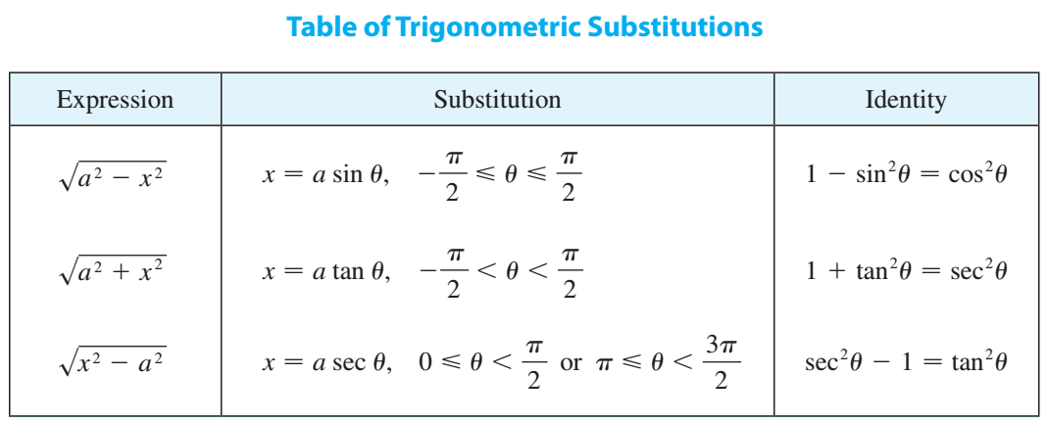

Trigonometric Substitutions
Example: Evaluate $\int{\frac{\sqrt{9−x^{2}}}{x}}dx$

Slide 11


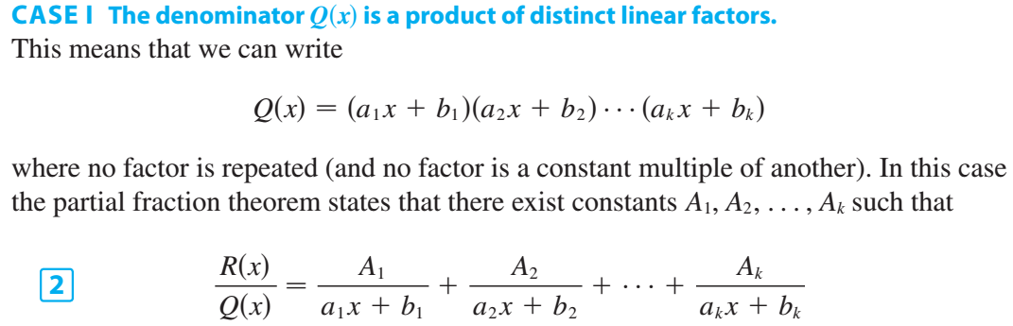
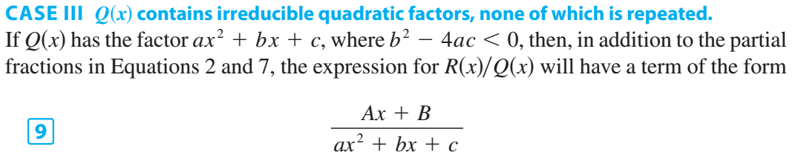
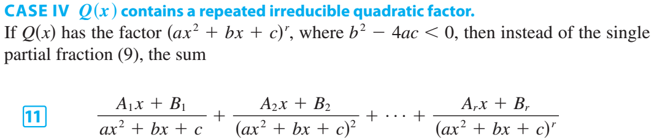
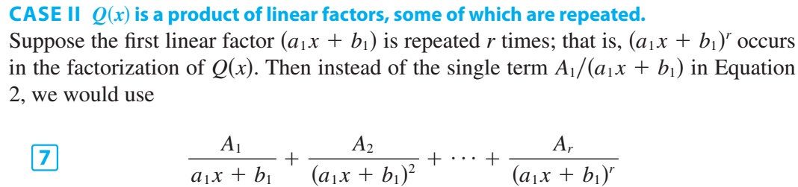
Integration of Rational Functions by Partial Fractions

Slide 12




Integration of Rational Functions by Partial Fractions

Slide 13
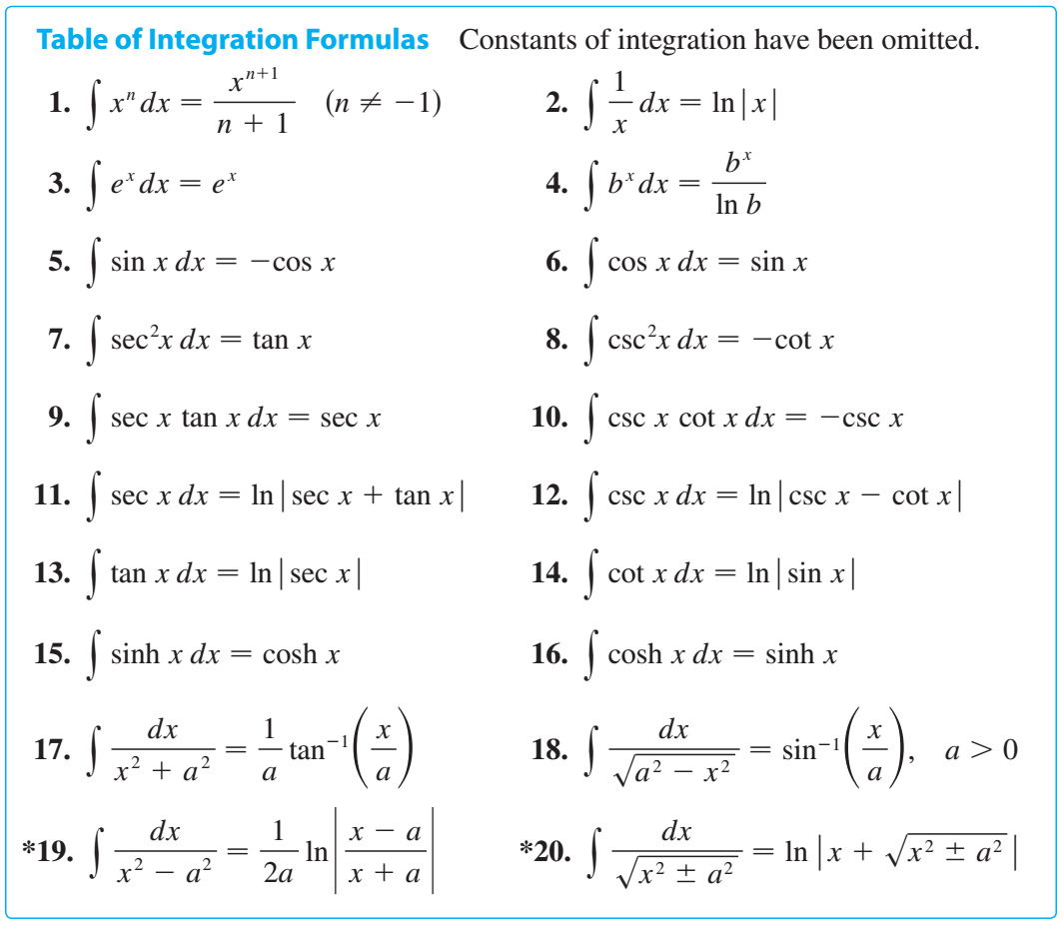
Strategy for Integration
Simplify the Integrand if Possible
Use Basic Formulas
Substitute
Classify the Integrand According to Its Form
Integration by parts
Trigonometric functions
Radicals
Rational functions
Try again
Try substitutions, try parts
Manipulate the integrand
Relate the problem to previous problems.
Use several methods

